Slide 1
BrightSource: Challenges and Prospects for a Concentrated Solar Power Plant
Team 2

Slide 2







Team 2
Shivani
Apurva
Himanshi
Dia
Robert

Slide 3
Table of Contents
01
02
03
05
06
07
04
Project
Summary
Project Cost & Schedule Baseline
Funding Requirements
Funding Schedule
Conclusion
Earned Value Analysis
Lessons Learned

Slide 4
01
Executive Summary

Slide 5
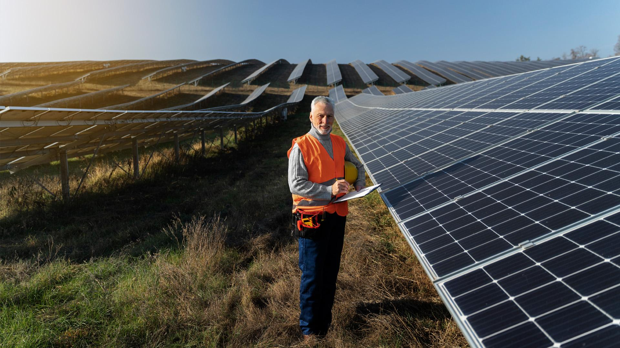
Executive Summary
Project
Name: Ivanpah Solar Electric Generating System
Developer: BrightSource Energy
Location & Area
Project Budget:
Timeline:
Capacity
Mojave Desert, California
Area: 3,600 acres
$2.2 billion with $1.6bn loan from DOE(Department of Energy)
Start : 2024
Total: 392 MW
Plant 1: 126 MW
Plant 2 & 3 : 133 MW each
Completion: 2028
Electricity Provision
Powers approx. 140,000 homes during peak hours
Energy Goals
Aligns with state and national renewable energy objectives
Technology
Utilizes concentrated solar power technology with approximately 170,000 software-operated mirrors.
Environmental Initiatives
Approximately $22mn was allocated for the relocation of tortoises existing on site for their conservation

Slide 6
02
Project Cost & Schedule Baseline

Slide 7
BrightSource's Work Breakdown Structure
Project Management
Project Closure
Community Management
Tortoise Rehabilitation
Concentrated Solar Power Facilities
Land Acquisition

Slide 8
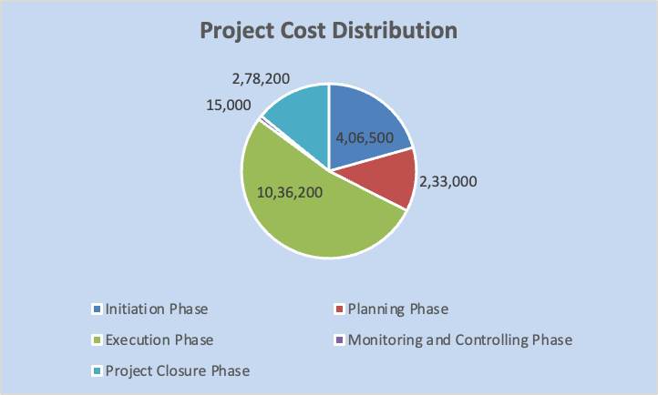
Summary of the Project Cost & Schedule Baselines
Major Deliverable | Baseline Start Date | Baseline End Date | Baseline Duration | Baseline Cost | Status as of June 27, 2024
Total Project | Thu 5/23/24 | Thu 6/22/28 | 1066 days | $1,968,900.00 | In Progress
Initiation Phase | Thu 5/23/24 | Fri 12/6/24 | 142 days | $406,500.00 | In Progress
- Project Management | Thu 5/23/24 | Wed 6/12/24 | 15 days | $0.00 | Completed
- Stakeholders Identification | Thu 5/23/24 | Thu 6/6/24 | 11 days | $38,700.00 | Completed
- Project Scope Definition | Fri 6/7/24 | Thu 8/1/24 | 40 days | $135,000.00 | In Progress
Planning Phase | Wed 6/12/24 | Mon 10/6/25 | 344 days | $233,000.00 | In Progress
Execution Phase | Wed 6/12/24 | Mon 3/27/28 | 989 days | $1,036,200.00 | Not Started
Monitoring and Controlling Phase | Wed 6/12/24 | Mon 3/1/27 | 709 days | $15,000.00 | In Progress
Project Closure Phase | Tue 3/28/28 | Thu 6/22/28 | 63 days | $278,200.00 | Not Started

Slide 9
03
Funding Requirements

Slide 10
Funding
Funding Sources
DOE Loan
Private Investors
Google
NRG Solar
Chevron
BP

Slide 11
$2.2 Billion
$1.6 Billion
$615 Million
Funding
Total Funding Requirement
Department of Energy (DOE) Loan
Pre-Approved
Private Investors

Slide 12
04
Funding Schedule

Slide 13
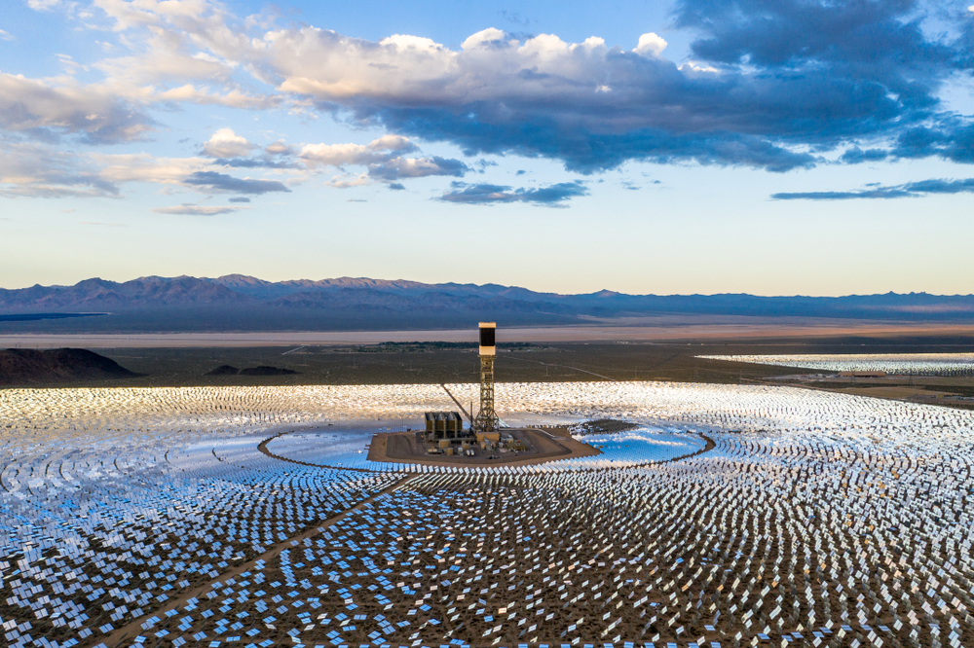
Ivanpah Concentrated Solar Power Plant
Initial Funding
DOE has guranteed a loan of $1.6 Billion
Private Investors
Private investors like Google, NRG Solar, Chevron and BP have decide to provide with Incremental funding.

Slide 14







Renewable Energy
Environmental Stewardship
Community Engagement
Objectives
Notes:
Renewable Energy Generation: Ivanpah aims to generate 392 megawatts of renewable electricity, supporting the transition towards sustainable energy sources and reducing reliance on fossil fuels.
Environmental Stewardship: The project prioritizes environmental protection, with special attention given to mitigating impacts on local wildlife, particularly the desert tortoise.
Community Engagement: Ivanpah actively engages with local communities to ensure alignment with broader social and environmental objectives, fostering positive relations and support for the project.

Slide 15

Project Phases
Planning and Permitting
2019-2024
Construction
2024 - 2028
Operational Phase
Starting mid 2028

Slide 16
05
Simulated project performance data analysis (Earned Value Analysis)

Slide 17
Schedule
Scope

Slide 18
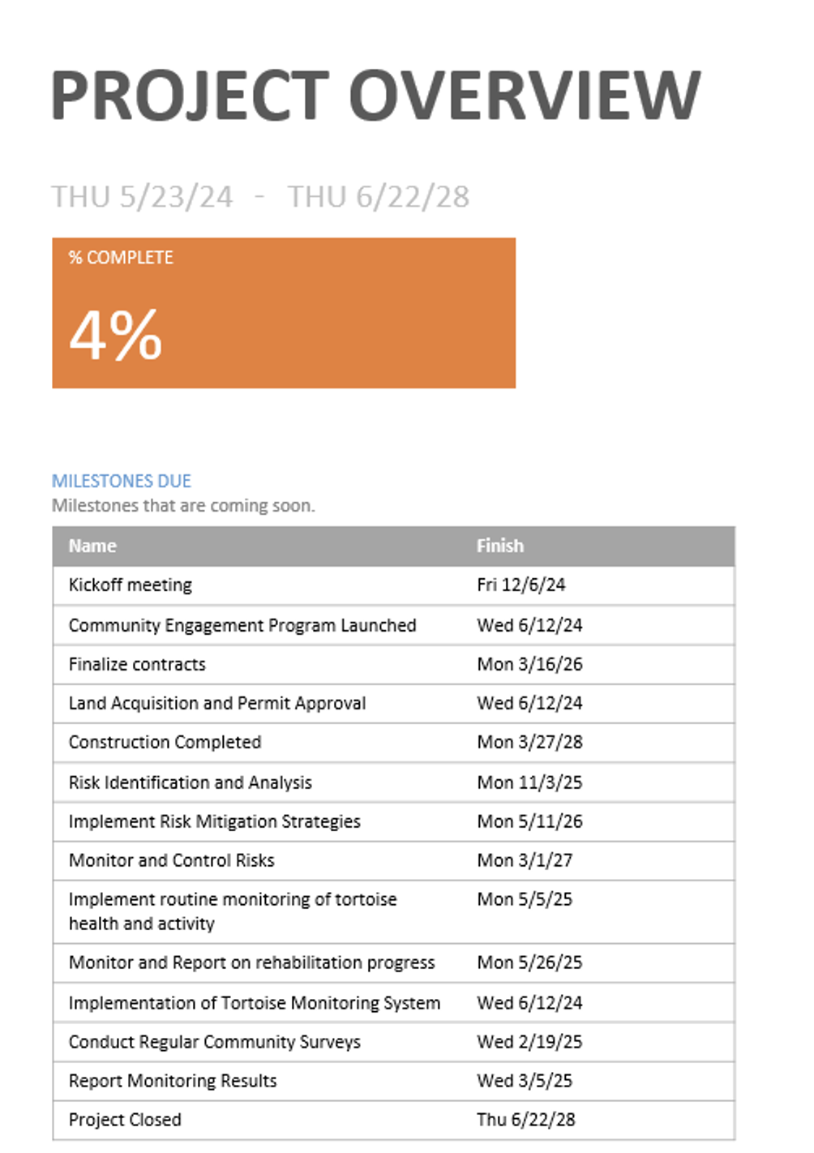
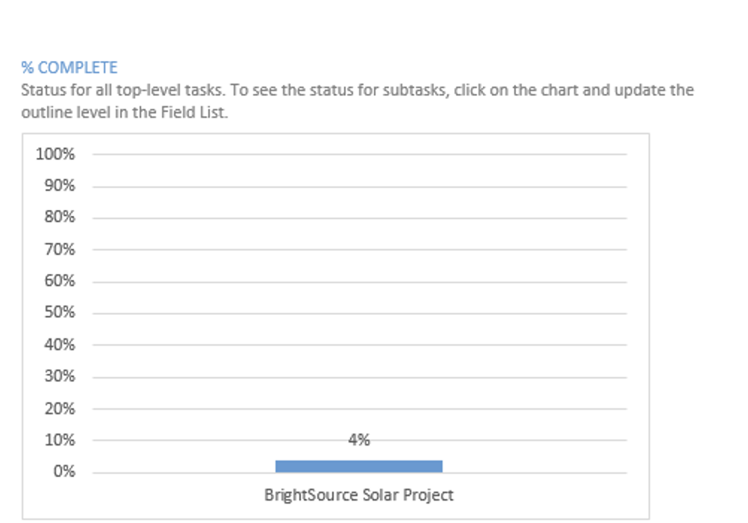

Slide 19
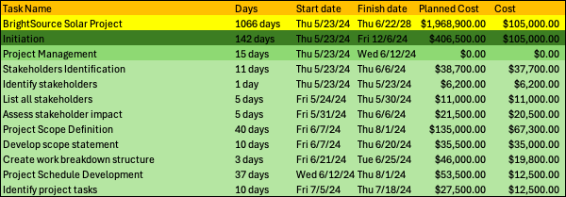
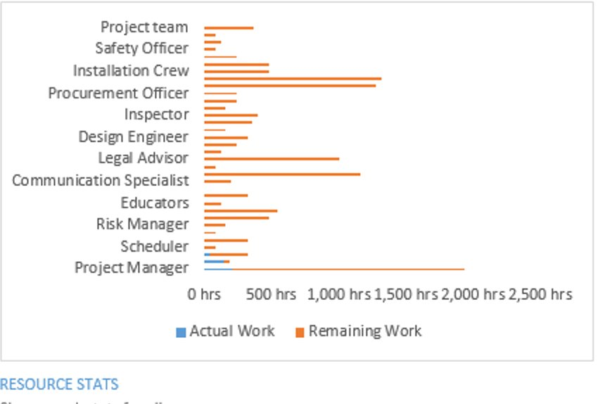

Slide 20
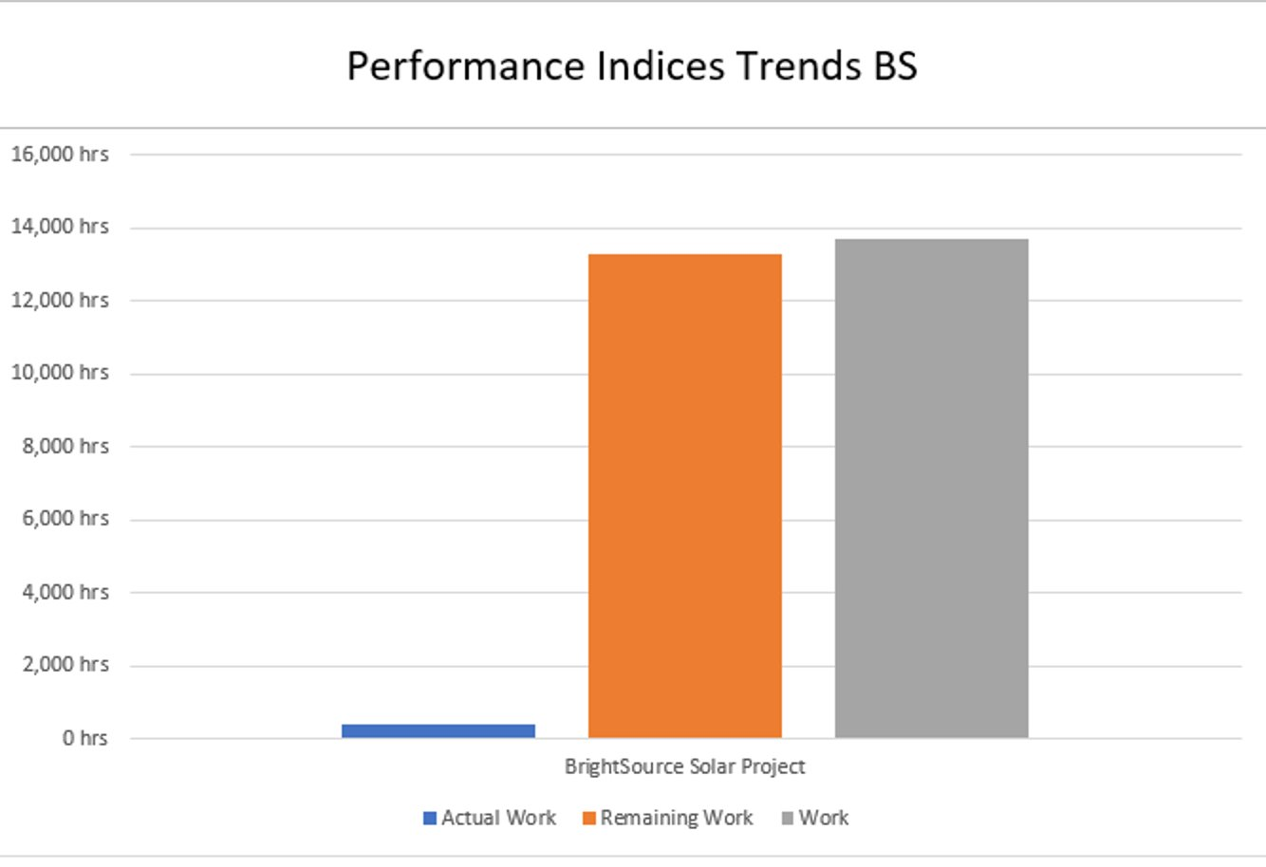
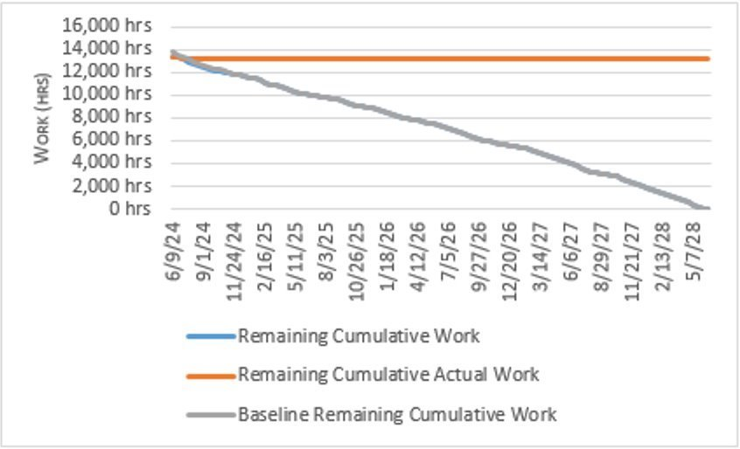

Slide 21
Cost

Slide 22
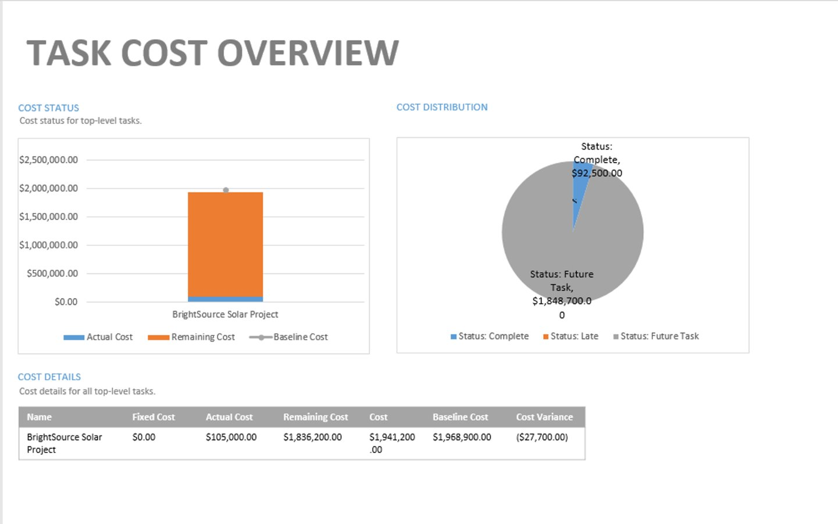
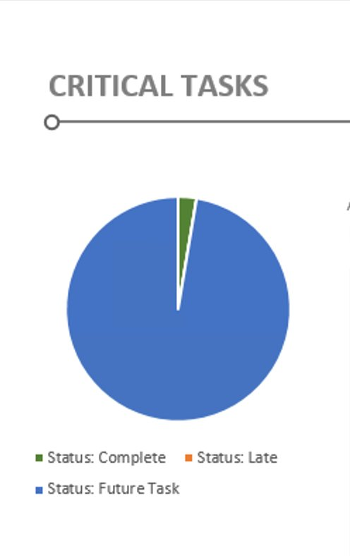

Slide 23
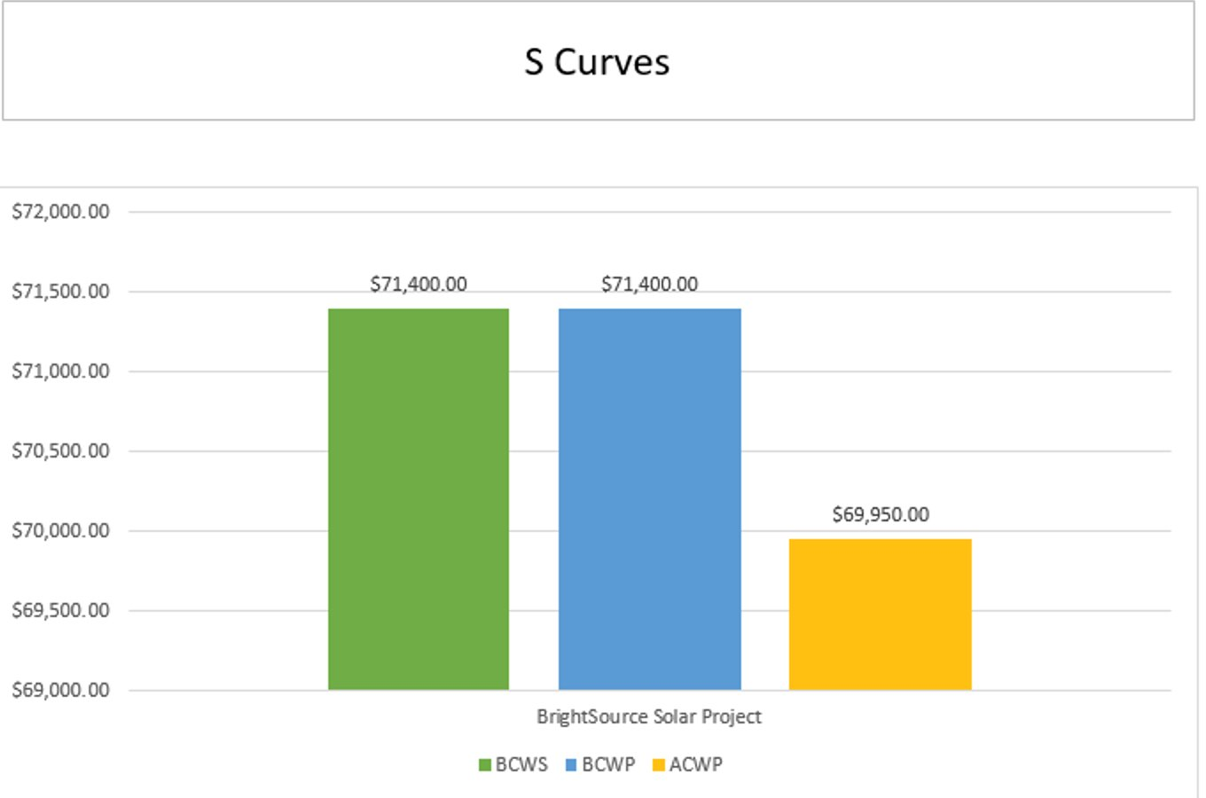
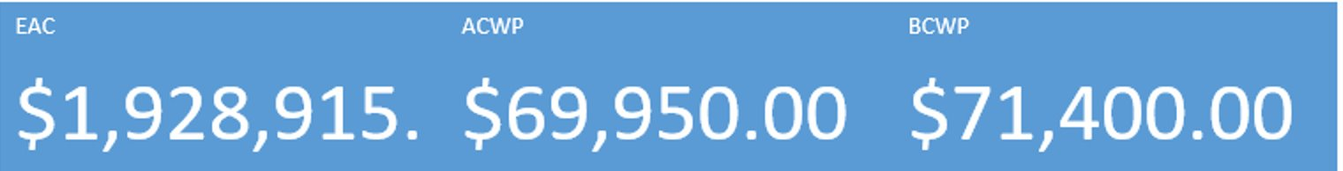

Slide 24
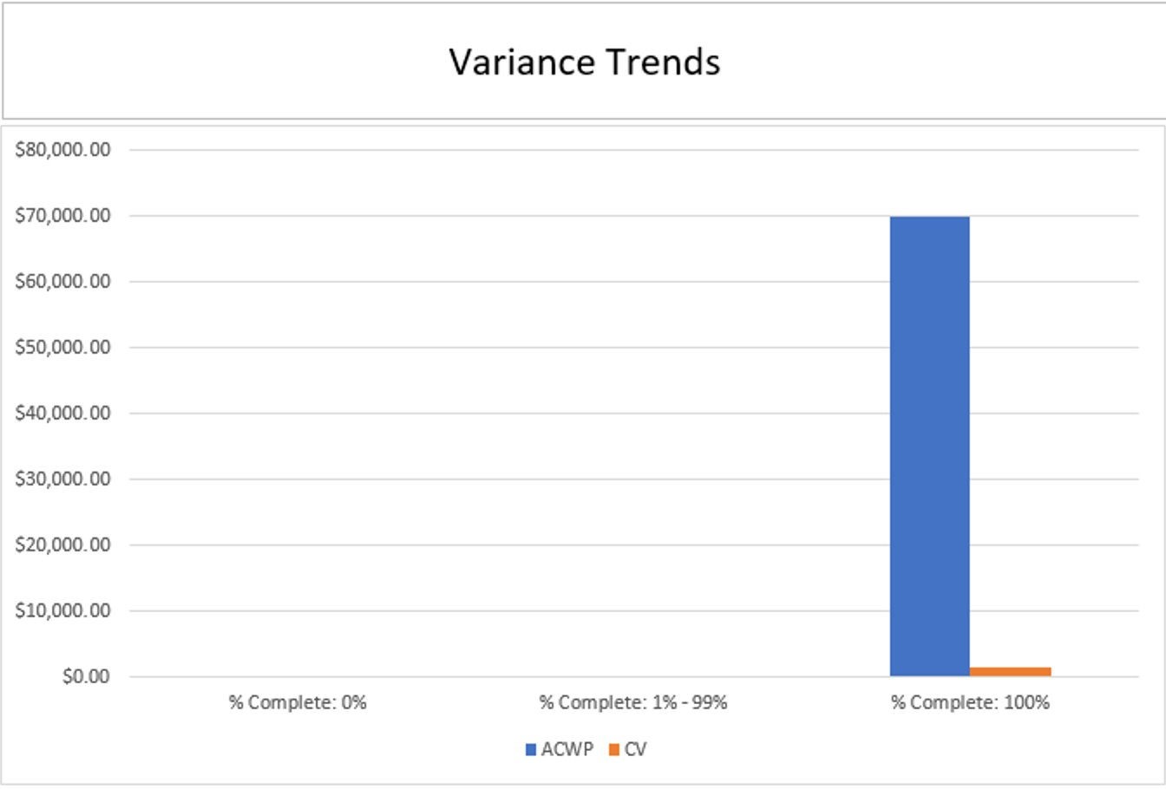
Task Name | SV | SPI | CV | CPI | VAC
Bright Source | $0.00 | 1 | $1,450.00 | 1.02 | $39,984.66
Initiation | $0.00 | 1 | $1,450.00 | 1.02 | $8,255.25
Project Management | $0.00 | 0 | $0.00 | 0 | $0.00
Stakeholders Identification | $0.00 | 1 | $1,000.00 | 1.03 | $1,000.00
Identify stakeholders | $0.00 | 1 | $0.00 | 1 | $0.00
List all stakeholders | $0.00 | 1 | $0.00 | 1 | $0.00
Assess stakeholder impact | $0.00 | 1 | $1,000.00 | 1.05 | $1,000.00
Project Scope Definition | $0.00 | 1 | $450.00 | 1.01 | $1,857.80
Develop scope statement | $0.00 | 1 | $450.00 | 1.01 | $488.53
Create work breakdown structure | $0.00 | 0 | $0.00 | 0 | $26,200.00

Slide 25
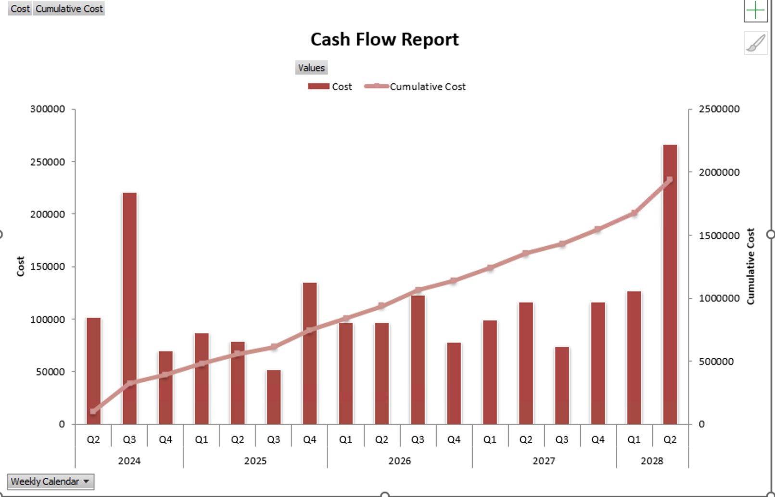

Slide 26
06
Lessons Learned

Slide 27


Lesson Learnt
Environmental Challenges
Legal and regulatory hurdles
Mitigation costs: $56 million for tortoise care
Habitat for threatened desert tortoise

Slide 28



Lesson Learnt
Technological and Financial Challenges:
High Levelized Cost of Energy (LCOE)
Need for dry-cooling technology to reduce water usage
Higher initial costs compared to PV systems

Slide 29


Lesson Learnt
Market Growth
Expanding renewable energy market domestically and internationally
Future projects with improved efficiency and lower costs

Slide 30
07
Conclusion

Slide 31
The Ivanpah Solar Electric Generating System project, scheduled from May 23, 2024, to June 22, 2028, has achieved 4% completion against a planned budget of $1.97 billion. The initiation phase, including stakeholder identification, is progressing smoothly. Project scope has been defined, the Work Breakdown Structure (WBS) created, and comprehensive cost estimation, budgeting, and scheduling have been conducted, supported by Earned Value Management (EVM) analysis. Cost management indicates a slight variance under budget, demonstrating need for financial oversight. Looking ahead, prioritizing timely execution of critical tasks and strict adherence to project milestones will be crucial for meeting project timelines and budgetary goals.

Slide 32
Thank You!

